Slide 1
A Preliminary Study on Indigenous Metrology: A Historical Approach to Pre-European Measurements.
Te Aomania Keita Te Koha
11.02.2019
Notes:
Kia ora everyone, my summer project is the research project on indigenous metrology, also known as the RAURU PROJECT. Which basically, takes a historical approach to find out what kind of measurements and measurement techniques were employed by pre-European Maori

Slide 2
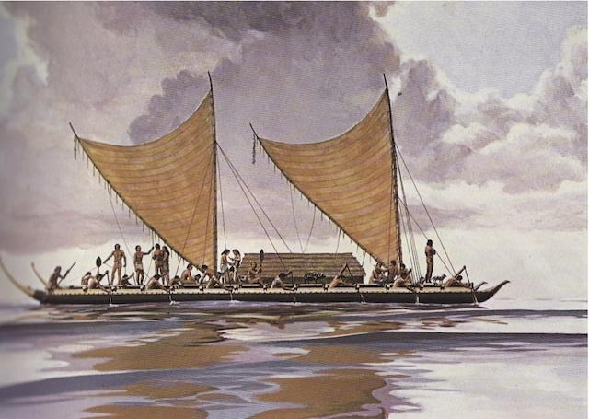
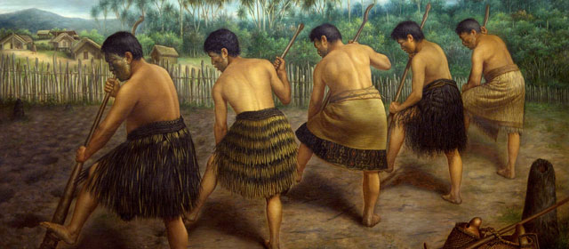
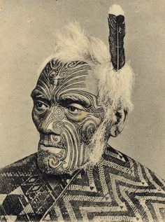
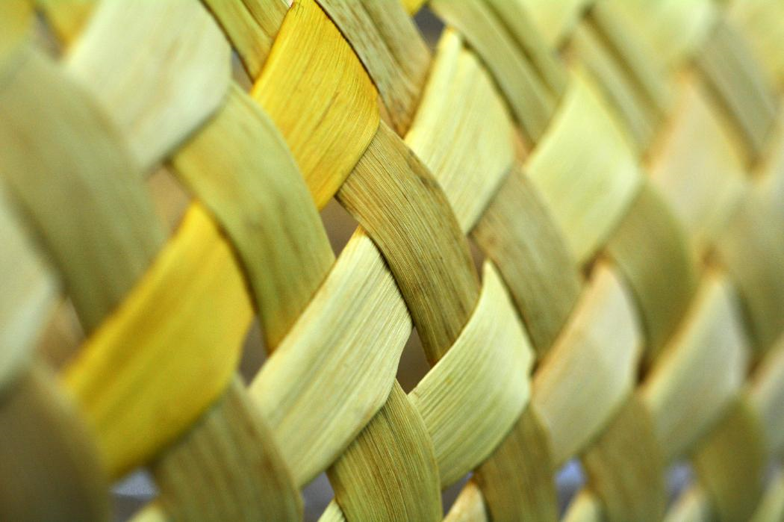
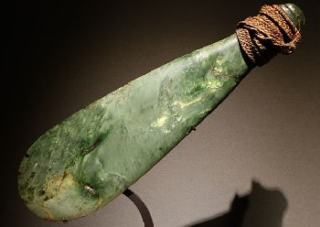
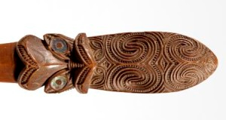
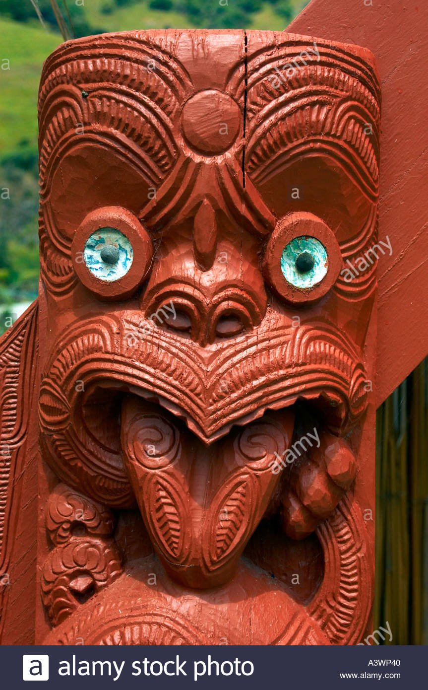
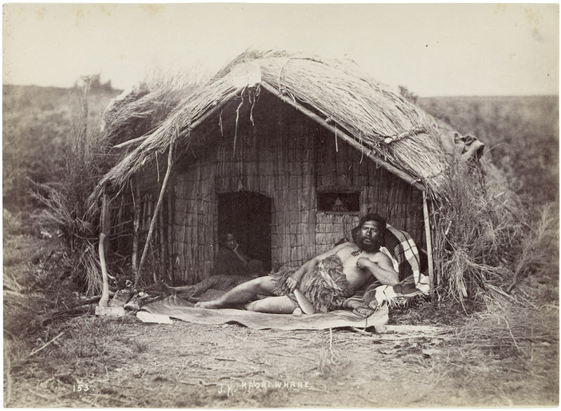
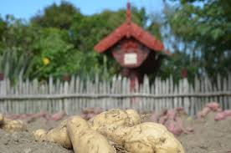
Ngā Inenga Māori:
Brief Māori history.
Notes:
So for our project, we looked back quite far, and in some points of the history, we found major points that suggested Maori were very much a people of science. For example, when we look at their voyage from Hawaiki, the ancestral Polynesian homeland, they managed to use astronomy and sub-tropical weather systems as their navigational guides. Another example is when they arrived to NZ and had brought over their Polynesian foods, such as the kumara, taro, ti poere and yam, they developed sophisticated horticulture techniques to acclimatise these plants to the lower temps of NZ, by heating the soil with stone walls and embers.
These are just a couple of examples that hint Māori had an excellent, natural sense of science. One particular example that regards their sense of measurement is the Maoris ability to build such strong and durable structures such as the wharenui and the waka. These practices/arts required a high-degree of precision and elements of measurements, which make it seem absolutely necessary for Maori to have a measurement system. But there has been no proof of such a system.
However, there is an account of one measurement method written by the famous, European ethnographer, Elsdon Best. Best’s work discusses a measuring-tool called the rauru.

Slide 3
Approach
Basis – Newspaper article + 20 documents.
E. Best, measures derived from human-body
Standardising measures, rauru.
Rauru no longer exists
From there…
Best and primary sources
Subjects of relevance
Other tohunga and scholars works
Interviews and kōrero
Notes:
So basically, when I got here, I was given a pile of 20 documents to look through, which was like the basis of our research. All of these documents were either written by Best, translated by Best or Best had contributed to these documents. So I just wanna emphasise that this research project was very dependent on Elsdon Best.
So to sum up Best’s work on Maori measurement, he says that Maori measurement units were derived from the human body, these measures were marked onto a rod, and then this rod would be used as a measuring tool.
Another important thing to note is that Maori were an oral people, so it has been quite difficult to find written text to contribute to this research project.
So we had to…
and we gathered a whole bunch of info on three different topics.
But just for today, I’m only going to briefly talk about the information that’s directly relevant to the research of measurement. So here it goes!

Slide 4
Māori Measurement
Human-body measures
Native Americans, the Egyptians, the Greeks, etc ¹
Variation of lengths, standardize measures
Selected rangatira (someone of high-status)
Rauru, the measuring-rod
Te Rauru-o-Kahungunu
1. History and Measurement of the Base and Derived Units by Steven A. Treese, 2018
Notes:
So yeah, before looking into rauru the measuring tool, I decided to look at these Maori measurement units, which Best states are derived from the human body.
I was actually unable to find any info on Maori measurement that wasn’t sourced by Elsdon Best, so instead I started looking at the development of measurement in other indigenous cultures which showed the that human-body measures was not uncommon among primitive man; it was seen in the histories of numerous cultures e.g. Native Americans, Egyptians, Greeks, etc (Treese, 2018). So it only seemed reasonable to consider the possibility that Māori may have used similar methods.
So let’s so say these ideas on human body measurement units were true, then these measurement standards were only used locally; each two prototypes of a unit could have been different in size because of the significant variation of body measures across each individual.
According to Best, to standardise a unit, Maori chose one person, who was usually rangatira, and their body measurements would be taken and marked onto either a cord or a rod. This measuring-rod was called the rauru.

Slide 5
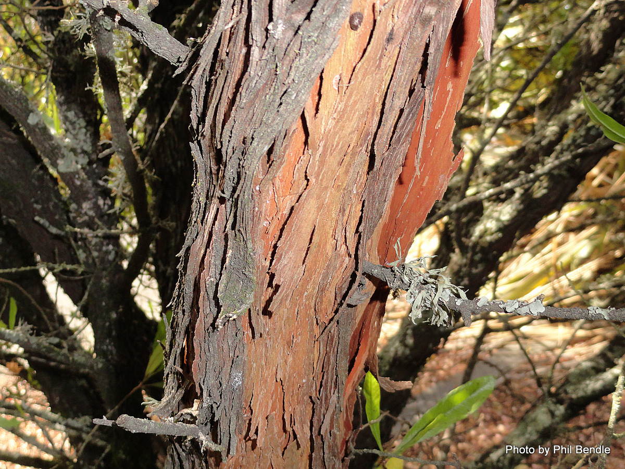
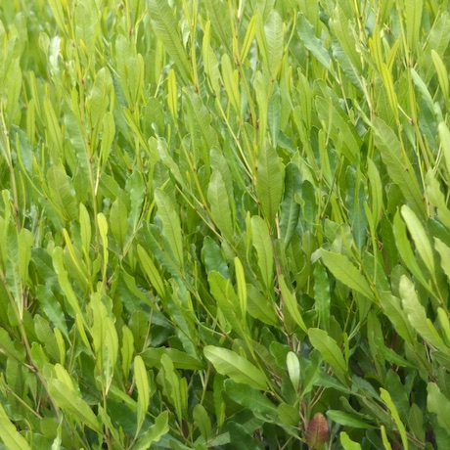
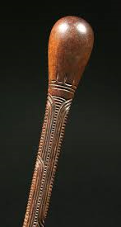
Rauru - Measuring Rod:
Confined to EC
A-iwi’ concepts
Plausible concept – rauru could have been an a-iwi measurement tool
Same idea for standard terms
Measures employed by East Coast
Notes:
It is said that rauru could have been confined to the East Coast region, or even parts of that region.
Must note that Māori were not a uniform people and that the time period our research is focused on is a time “when there was some diversity occurring from within the broader context of Māori culture”.
Each tribe had their own dialect, techniques for hunting, fishing and various other activities, their own style for arts, practices and much more.
Considering this diversity, attempting to highlight some absolute measuring process or technique is unrealistic. A more plausible argument would be that this particular measuring tool could have been an instrument employed by one or few tribes.
(also explain why there is such a limited amount of knowledge about the artefact)
Diverse dialect across different iwi would lead to the likely possibility that these human-body measures having no universal terms or names. Following definitions of measurement units were all units obtained from East Coast tribes

Slide 6
Measurement Units:
Table 1: Definitions of the pre-European Māori measurement standards
Māori measurement standard name: | Human-body length:
Konui, pona konui | Length of the first joint of the thumb
Koiti, koroiti | Length of the little finger
Ringa | Width of the hand
Matikara | Span of outspread fingers
Awanui | Span of two outspread hands, thumb tips together
Tuke, tuke ringa, whatianga | The cubit. Elbow to finger tips
Pakihiwi, tumu | Length of arm. Shoulder to finger tips
Hau or wahanga | The half māro. From middle of breast to finger tips of outstretched arm
Pakihiwi-māro | Length of arm plus width across shoulders
Māro, whanganga, aronui | The fathom. Span of arms outstretched horizontally
Pae | Same as māro but arms curved; used in measuring circumference of trees
Takoto | Length of prone body plus that of arm outstretched beyond the head
Kumi | Ten māro , or ten arm fathoms
Source: Adapted from (Best, XIII The Dawn of Science the Rudiments of Modern Science as Observed in Maori Usages, 1941), see (Best, Papers/ Series 3 - Notebooks, 1856 - 1931).
Notes:
Names of these units either directly translate or emerge from the Māori names of the particular body parts involved with each unit. E.g. koiti,
e.g. takoto unit is defined as the length of prone body plus that of arm outstretched beyond the head, while the maori word takoto translates to ‘to lie down’

Slide 7
Measurement Units:
Table 1: Definitions of the pre-European Māori measurement standards
Māori measurement standard name: | Human-body length:
Konui, pona konui | Length of the first joint of the thumb
Koiti, koroiti | Length of the little finger
Ringa | Width of the hand
Matikara | Span of outspread fingers
Awanui | Span of two outspread hands, thumb tips together
Tuke, tuke ringa, whatianga | The cubit. Elbow to finger tips
Pakihiwi, tumu | Length of arm. Shoulder to finger tips
Hau or wahanga | The half māro. From middle of breast to finger tips of outstretched arm
Pakihiwi-māro | Length of arm plus width across shoulders
Māro, whanganga, aronui | The fathom. Span of arms outstretched horizontally
Pae | Same as māro but arms curved; used in measuring circumference of trees
Takoto | Length of prone body plus that of arm outstretched beyond the head
Kumi | Ten māro , or ten arm fathoms
Source: Adapted from (Best, XIII The Dawn of Science the Rudiments of Modern Science as Observed in Maori Usages, 1941), see (Best, Papers/ Series 3 - Notebooks, 1856 - 1931).
Notes:
Names of these units either directly translate or emerge from the Māori names of the particular body parts involved with each unit. E.g. koiti,
e.g. takoto unit is defined as the length of prone body plus that of arm outstretched beyond the head, while the maori word takoto translates to ‘to lie down’

Slide 8
Measurement Units:
Table 1: Definitions of the pre-European Māori measurement standards
Māori measurement standard name: | Human-body length:
Konui, pona konui | Length of the first joint of the thumb
Koiti, koroiti | Length of the little finger
Ringa | Width of the hand
Matikara | Span of outspread fingers
Awanui | Span of two outspread hands, thumb tips together
Tuke, tuke ringa, whatianga | The cubit. Elbow to finger tips
Pakihiwi, tumu | Length of arm. Shoulder to finger tips
Hau or wahanga | The half māro. From middle of breast to finger tips of outstretched arm
Pakihiwi-māro | Length of arm plus width across shoulders
Māro, whanganga, aronui | The fathom. Span of arms outstretched horizontally
Pae | Same as māro but arms curved; used in measuring circumference of trees
Takoto | Length of prone body plus that of arm outstretched beyond the head
Kumi | Ten māro , or ten arm fathoms
Source: Adapted from (Best, XIII The Dawn of Science the Rudiments of Modern Science as Observed in Maori Usages, 1941), see (Best, Papers/ Series 3 - Notebooks, 1856 - 1931).
Notes:
Names of these units either directly translate or emerge from the Māori names of the particular body parts involved with each unit. E.g. koiti,
e.g. takoto unit is defined as the length of prone body plus that of arm outstretched beyond the head, while the maori word takoto translates to ‘to lie down’

Slide 9
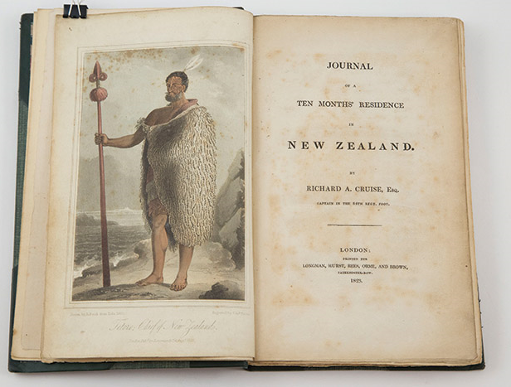
Takoto Siting
Takoto unit = Length of prone body plus that of arm outstretched beyond the head
Journal of a Ten Months' Residence in New Zealand
“He alone came up the side, and after gazing about for some time, proceeded to measure the ship from stem to stern. This he effected by prostrating himself upon the deck, and marking upon it the distance of his hands, which he extended as far beyond his head as he could, counting at the same time the number of prostrations he made.”
(Cruise, April 27th 1824).
Notes:
Another interesting fact about the takoto unit of measurement is that there has been proof that Maori used this method. – On April 27th 1824, Captain Cruise wrote a journal entry which describes a native North Cape chief and approximately 60 of his men coming to Cruise’s ship on two of their war-canoes to measure the ship. Cruise says that… quote.
Evidence that a measurement method such as the takoto method was employed by Māori - perhaps it is indeed true that the rest of these units were exercised too.

Slide 10
Measurement Units:
Table 1: Definitions of the pre-European Māori measurement standards
Māori measurement standard name: | Human-body length:
Konui, pona konui | Length of the first joint of the thumb
Koiti, koroiti | Length of the little finger
Ringa | Width of the hand
Matikara | Span of outspread fingers
Awanui | Span of two outspread hands, thumb tips together
Tuke, tuke ringa, whatianga | The cubit. Elbow to finger tips
Pakihiwi, tumu | Length of arm. Shoulder to finger tips
Hau or wahanga | The half māro. From middle of breast to finger tips of outstretched arm
Pakihiwi-māro | Length of arm plus width across shoulders
Māro, whanganga, aronui | The fathom. Span of arms outstretched horizontally
Pae | Same as māro but arms curved; used in measuring circumference of trees
Takoto | Length of prone body plus that of arm outstretched beyond the head
Kumi | Ten māro , or ten arm fathoms
Source: Adapted from (Best, XIII The Dawn of Science the Rudiments of Modern Science as Observed in Maori Usages, 1941), see (Best, Papers/ Series 3 - Notebooks, 1856 - 1931).
Notes:
Another interesting thing about the all the units listed is that there is only one unit that is a multiple of a preceding unit; the kumi unit. This was important for us to note because this could be considered Maori’s first step towards producing a scientific system of measurement.
One kumi unit is equivalent to ten maro units.
Seeing that this unit was a base-10 unit lead us to investigate the possibility of decimal systems in Maori numeration, and in turn, Maori measurement.

Slide 11
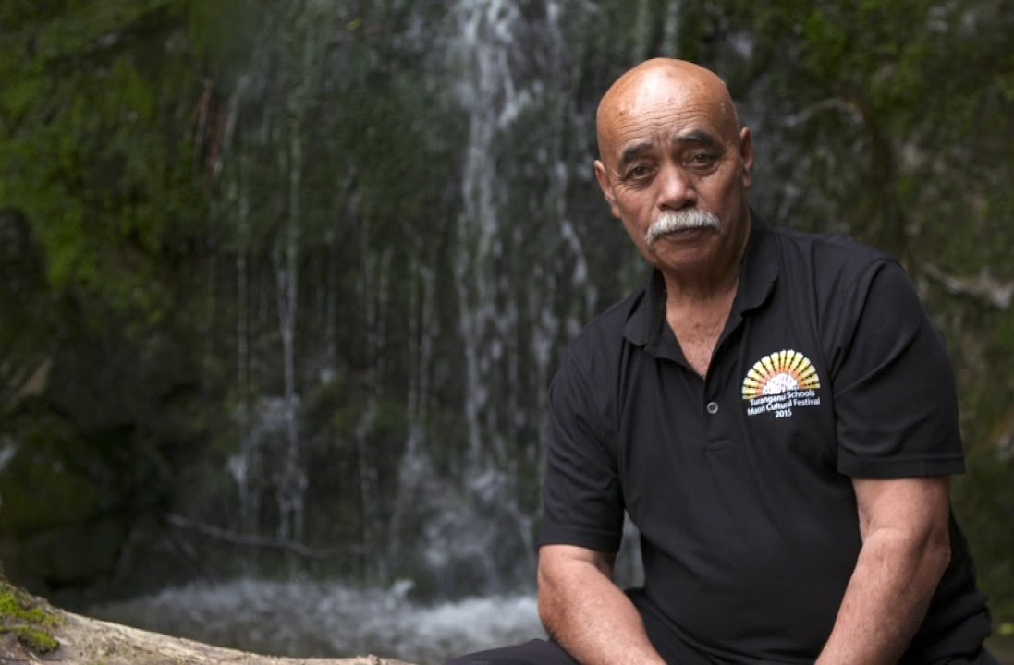
Taina Ngarimu,
Ngāti Porou
“When Pāpā Joe was working on Materoa Whare, he said that Māori must have had a measuring system that related to some sort of decimal system because everything was in groups of tens.”
(Ngarimu, 2018).
Notes:
On the subject of decimal measurement systems, I thought I’d share some relevant kōrero, to this base-10 unit idea, that was collected during the interviewing stages of the research. One of our interview participants is Taina Ngarimu, educationalist and well-known kaumātua from Whareponga Marae, of the Ngāti Porou tribe.
He shared a story about his brother, Joe Ngarimu, who is a builder, who worked on Te Poho-o-Materoa, which is the meeting house at Whareponga Marae.
Taina says…
Could have been kumi, could have been another unit - Still trying to get in contact with Joe.
Māori numeration and construction of whare.

Slide 12
Māori Numeration
Table 2: Traditional and Contemporary Māori digits.
Number: | Pre-European Māori term: | Contemporary Māori term:
1 | Tahi | Tahi
2 | Rua | Rua
3 | Toru | Toru
4 | Whā | Whā
5 | Rima | Rima
6 | Ono | Ono
7 | Whitu | Whitu
8 | Waru | Waru
9 | Iwa | Iwa
10 | Ngahuru | Tekau
Source: (Williams, 1852)
Ngahuru – naming.
Notes:
Concepts of measurement and numbers are evidently connected. Subsequently, for the purpose of this research, Māori numeration and the development of counting systems are essential focuses in gaining an advanced understanding of primal Māori concepts and methodologies of measurement
Maori numeration.
We found lots of little interesting facts about Maori numeration, but today, I’m only mentioning a couple finds regarding human body measures.
Looking at the first ten pre-European digits, there is only one term no longer used in contemporary Maori language, which is the old term for ten; ngahuru.

Slide 13
Naming of Ngahuru
Huru
1. to draw in
Ngā
1. (particle) (determiner) the - plural of te
Ngahuru = Both hands with all fingers drawn in
Notes:
The term ngahuru was used for the numeral ten because of the combination of the root words within ngahuru; nga and huru.
Nga is te plural of te, while te just means ‘the’.
Huru means to draw in, or contract.
It is said that Ngahuru was the term to describe the counting of ten on mans fingers – by holding your hands out and drawing in each finger to count. Once you had counted to ten, both hands would have all fingers drawn in, which is why nga is added to huru.
Thought this was interesting to add as it shows that even the naming of the maori numeral terms could have been based on the human body.

Slide 14
Māori Counting System
# | Māori
1 | tahi
2 | rua
3 | toru
4 | whā
5 | rima
6 | ono
7 | whitu
8 | waru
9 | iwa
10 | tekau
10² | rau
10³ | mano
10⁴ | tekau mano
10⁵ | rau mano
A true base-10 system of counting shows a clear recurrence of powers on the number 10.
Source: The Journal of the Polynesian Society (Bender, "FANCIFUL" OR GENUINE? BASES AND HIGH NUMERALS IN POLYNESIAN NUMBER SYSTEMS, 2006) (Beller S. , 2006).
Notes:
The other thing we found in Maori numeration was a very obvious base-10 system. A true base-10 system of measurement shows a clear recurrence of powers on the number 10, which is clearly seen in Maori numeration, showing that Maori employ a decimal counting system, which is common in most ancient civilizations.
Ethnographers continue to speculate the history of the decimal system, since there is still very little evidence to help us clarify its origin. Several cultural historians have suggested possible explanations of the base-10 system, one of the most commonly accepted theories is that pre-historic man counted on his fingers.

Slide 15
Origins of counting systems
“The great preponderance of people use a basic decimal or decadic group of 10 objects, as one should expect from counting on the fingers.”
(Ore, 1988).
Egyptians – decimal (base-10
Greeks – decimal (base-10) and quinary (base-5)
Romans – quinary (base- 5)
American-Indian – vigesimal (base-20)
Base-10
Fingers on both hands
Base-5
Fingers on one hand
Base-20
Fingers and toes
Base-4
Spaces between fingers on one hand
Base-8
Spaces between fingers on both hand
Notes:
Øystein Ore was a Norwegian mathematician known for his work the history of mathematics. He suggests that most counting systems are derived from the human-body
He theorises that base-5 system was derived from counting the fingers of one hand. Some other cultures used different number bases. For example, some of the American Indian tribes applied the vigesimal system which is a base-20 counting system that is believed to have been established by counting on both fingers and toes. There have also been theories about base-4 and base-8 counting systems, arisen from counting the spaces between fingers.
There are many historians that theorise that the origins of multiple counting systems are derived from the human-body. Which makes us think that the origins of numeration correspond to the prehistoric development of measurement. There is no evidence clarifying their histories, however, there are multiple theories in various cultures, including the Maori culture, about numeration and measurement that emphasise the commonly-accepted idea of each being a derivative of types of human-body measures.

Slide 16
Ngā Inenga Māori:
Measurement
Measures derived from human-body
Standardise, rauru, measuring tool
Māori numeration
Numerical terms
Counting systems, origins
Human-body based
Whare construction
Measures – Roman Measures, whare wānanga and te aho.
Construction - taura tīeke
Rauru - plaiting of three or more strands, umbilical cord, Rauru-nui-a-Toi
Notes:
Rauru as a measuring tool:
Expand the ideas and knowledge of the Māori human-body measurement standards that were mentioned in the (Maori Measurements, 1918) article.
Potential development of these standards into units to build a scientific system of measurement
Māori numeration and enumeration and examples where these numbering systems are used in Māoridom.
Works and practices that required such a tool, such as building whare, making waka, etc, and being able to present examples of this practice of measurement actually being used
Other past measuring processes that were exhausted
Process of how these measuring mechanisms were handed down to the next generation eg. through the ancient teachings of whare wānanga, by one family’s generation to the next, etc.
The ancestor named Rauru, which
History and genealogy.
Possibility of acquiring links between Rauru, the ancestor, and the measuring-rod in question.
Ancestor’s connection to the East Coast iwi and customs of that specific region, and any other region that Rauru may have resided in.
It is important to note that numerous Māori words and names tend to originate from names and/or root words of things or people that share similar features, functions or ideas with the initial word. This idea influences the need to investigate Rauru’s character as a person, through stories, waiata and whakatauki, to uncover any potential relevance between the ancestor’s name and the naming of the measuring rod.
Rauru the umbilical cord.
Traditional birthing practices
Umbilical cord and birthing references that are seen across other elements of this research,
Depictions of the umbilical cord in carving
Similarities that are seen in the umbilical cord and taura, or cord/rope, which were said to be used for measuring purposes; this may reveal possible connections to the measurement tool, rauru.
These three major topics are significantly different to each other
Each unravel different aspects of the word rauru
Helps us to interpret the probability of the measuring rod’s existence.

Slide 17
Conclusion:
Māori employed human-body measurement units, as well as a base-10 counting system, and had shown steps towards developing a decimal measurement system.
The term rauru has not been heard or mentioned by anyone else in our works.
Unlikely that rauru was a commonly used term for the measuring tool in question.
However, rauru is the term for a type of cord.
Cord/ taura has been seen in other Maori measuring processes.

Slide 18
Te Aomania Keita Te Koha
Student Intern, Measurement Standards Laboratory
www.measurement.govt.nz

